Slide 1



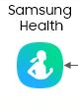

Nutri AI
Create Account
Username:
Password:
Or
Log in with your health tracker accounts
“To eat is a necessity, but to eat intelligently is an art”
La Rochefoucald

Slide 3




Nutri AI
Menu Page
Home Page
User Profile
Log a Meal
Get Recipes
Get Advice
“To eat is a necessity, but to eat intelligently is an art”
La Rochefoucald

Slide 4

Nutri AI
User Profile
Name: John Doe
Age: 27
Gender: Male
Height (cm): 175
Weight (lb): 210
BMI: 20.6
Calories consumed today: 1840
Calories burnt today: 650
Calories consumed total: 482340
Calories burnt total: 283420
“To eat is a necessity, but to eat intelligently is an art”
La Rochefoucald

Slide 5
Nutri AI
Log Your Meal
Log your meal
Logged Meal:
Total calories:
Ingredients:
Calories consumed:
Calories remaining:
1840
1000
“To eat is a necessity, but to eat intelligently is an art”
La Rochefoucald

Slide 6
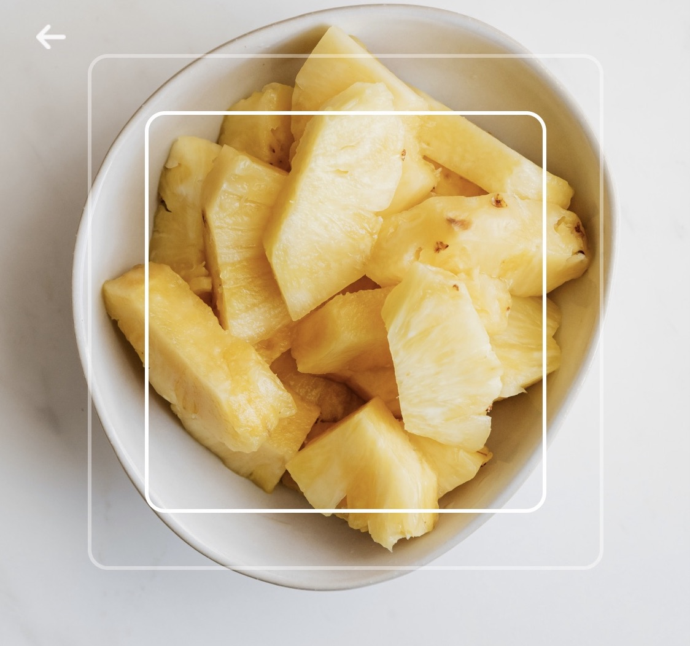
Nutri AI
Log Your Meal
120 calories
Check Nutrition Facts
“To eat is a necessity, but to eat intelligently is an art”
La Rochefoucald

Slide 7
Team Info
Team Member | Unity ID
Ruby Albers | rcalber2
Sisira Boppana | sboppan
Bhoomi Mehta | bmehta
Sara Chandorkar | schando
Noah Conrad | ncconrad

